Slide 1
CRIMES IN BOSTON
This project revolves around the information regarding crimes that had happened in Boston.
siddhant kumar(pes2201800129)
Shreya mk (pes2201800679)
shrushti hedge(pes2201800652)
YOGESH(PES2201900809)

Slide 2
ABSTRACT
Context Crime incident reports are provided by Boston Police Department (BPD) to document the initial details surrounding an incident to which BPD officers respond.
This is a dataset containing records from the new crime incident report system, which includes a reduced set of fields focused on capturing the type of incident as well as when and where it occurred.
Content Records begin in June 14, 2015 and continue to September 3, 2018.

Slide 3
DATASET
Dataset link: https://www.kaggle.com/AnalyzeBoston/crimes-in-boston/downloads/crimes-in-boston.zip/2
Number of rows:319074
Number of columns:17
Each row represents a crime report, including: the type of crime, date and time, and location.
NUMERICAL COLUMNS:
INCIDENT,OFFENCE_CODE,REPORTING_AREA,OCCURR ED_ON_DATE,MONTH,HOUR,Lat,Long
CATEGORICAL COLUMNS:
OFFENCE_CODE_GROUP,OFFENCE_DESCRIPTION,DISTRICT,DAY_OF_WEEK,UCR_PART,STREET

Slide 4
VARIABLE DESCRIPTION
SL NO | NAME | DESCRIPTION | TYPE
1 | INCIDENT NUMBER | ORDER | STRING
2 | OFFENCE CODE | CRIME NUMBER | INTEGER
3 | OFFENCE CODE GROUP | CRIME TYPE GROUP | STRING
4 | OFFENCE DESCRIPTION | CRIME EXPLANATION | STRING
5 | DISTRICT | DISTRICT | STRING
6 | REPORTING AREA | PLACE | INTEGER
7 | SHOOTING | NULL | UUID

Slide 5
SL NO | NAME | DESCRIPTION | TYPE
8 | OCCURRED_ON_DATE | DATE | DATE
9 | YEAR | YEAR | INTEGER
10 | MONTH | MONTH | INTEGER
11 | DAY OF WEEK | DAY | STRING
12 | HOUR | TIME | INTEGER
13 | UCR PART | PART DESCRIPTION | STRING
14 | STREET | PLACE OF OCCURENCE | STRING
15 | LAT | LATITUDE | LATITUDE
L16 | LONG | LONGITUDE | DECIMAL
17 | LOCATION | LAT AND LONG | STRING

Slide 6
STEPS
These are the steps that we will undertake:
Data Cleaning
Visualization and Analysis
Normalization
Correlation
Hypothesis Testing

Slide 7
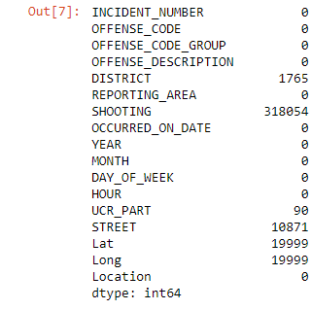
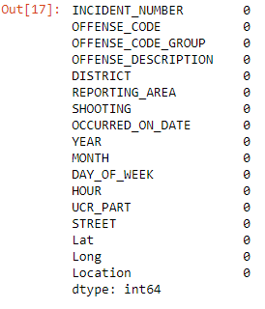
DATA CLEANING
code
#We have replaced the NAN values with the most frequent values
data=pd.read_csv("crime.csv",encoding='latin-1).
data.isnull().sum()#For analysing the null values
print(data.info())
data=data.fillna(data['SHOOTING'].value_counts().index[0]);
data=data.fillna(data['STREET'].value_counts().index[0]);
data=data.fillna(data['Lat'].value_counts().index[0])
data=data.fillna(data['DISTRICT'].value_counts().index[0])
data=data.fillna(data['Long’].value_counts().index[0])
data.head()
output

Slide 8
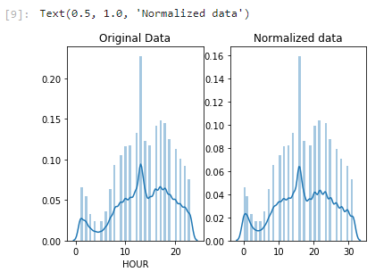
NORMALIZATION a type of process wherein data within a database is reorganized in such a way so that users can properly utilize that database for further queries and analysis.
.
COMPARISION
# normalize the exponential data with boxcox mean_hour=data['HOUR'].mean() data=data.replace({'HOUR':{0:mean_hour}}) normalized_data = stats.boxcox(data['HOUR']) # plot both together to compare fig, ax=plt.subplots(1,2) sns.distplot(data['HOUR'], ax=ax[0]) ax[0].set_title("Original Data") sns.distplot(normalized_data[0], ax=ax[1]) ax[1].set_title("Normalized data")

Slide 9
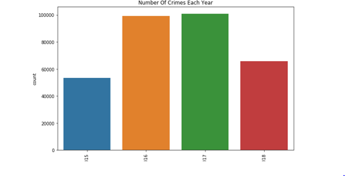
VISUALIZATION
Conclusion: In this graph, we can see that 2016 and 2017 had the highest incidence of the region
import numpy as np
import pandas as pd
import matplotlib.pyplot as plt
import seaborn as sns
from sklearn.preprocessing import scale
from scipy import stats
#Visualization of dataset
plt.subplots(figsize=(10,6))
sns.countplot('YEAR',data=data)
plt.xticks(rotation=90)
plt.title('Number Of Crimes Each Year')
plt.show()

Slide 10
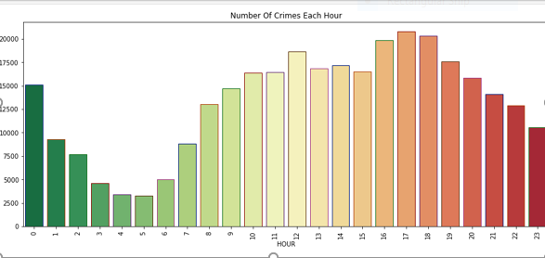
Conclusion : Here we can see that from 7 am onwards, the occurrence of crimes begins to rise, peaking at between 5 and 6 pm.
VISUALIZATION
GRAPH
plt.subplots(figsize=(15,6))
sns.countplot('HOUR',data=data,palette='RdYlGn_r',edgecolor=sns.color_palette('dark',7))
plt.xticks(rotation=90)
plt.title('Number Of Crimes Each Hour')
plt.show()

Slide 11
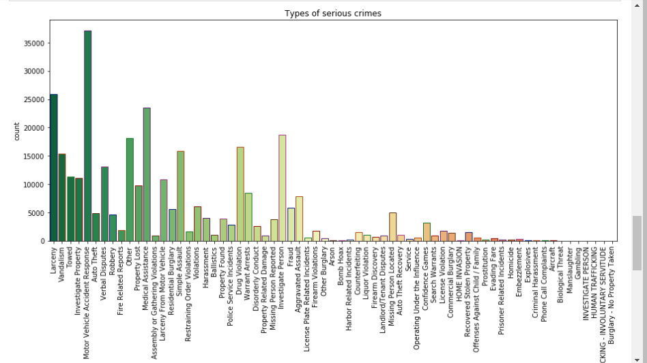
Conclusion: It shows the count of different serious crimes taking place in boston
VISUALIZATION
plt.subplots(figsize=(15,6))
sns.countplot('OFFENSE_CODE_GROUP',data=data,palette='RdYlGn_r',edgecolor=sns.color_palette('dark',7))
plt.xticks(rotation=90)
plt.title('Types of serious crimes')
plt.show()

Slide 12
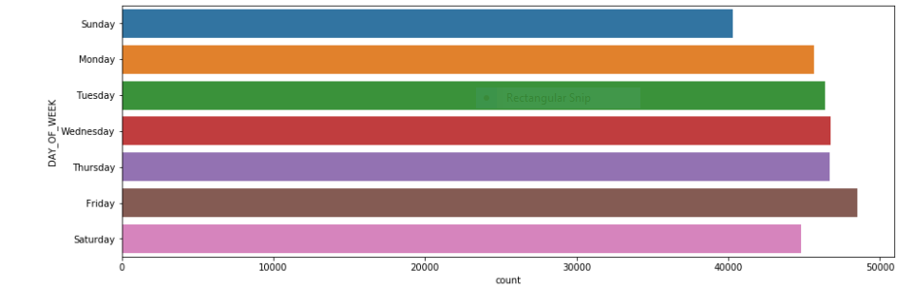
#What is the safest day to be out in the streets in Boston ? #Interference:Based on the frequencey of the crimes, weekend appears to relatively safest day to be out in Boston.
plt.figure(figsize=(15,5))
cPlot=sns.countplot(y="DAY_OF_WEEK",data=data,
order=['Sunday','Monday','Tuesday','Wednesday','Thursday','Friday','Saturday'])

Slide 13
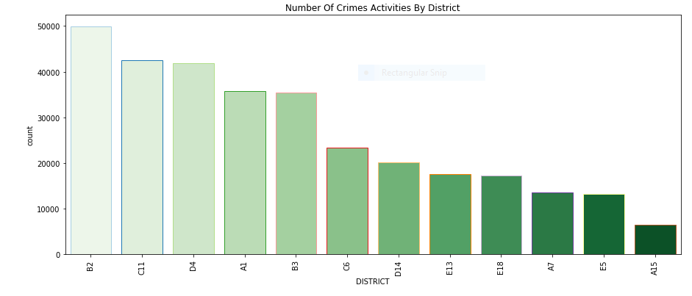
#inference for the below graph:In this graph, we organize the data by the district to observe the occurrence of crimes in each of them. With the ordered date, we can see and conclude that the neighborhood with the highest incidents of crime is B12, followed respectively by C11, D4, B4, C6, D14, E13, E18, A7, E5, and A15.
plt.subplots(figsize=(15,6))
sns.countplot('DISTRICT',data=data,palette='Greens',edgecolor=sns.color_palette('Paired',20),order=data['DISTRICT'].value_counts().index)
plt.xticks(rotation=90)
plt.title('Number Of Crimes Activities By District')
plt.show()

Slide 14
CORRELATION Its a statistical technique which gives the relationship between the variables. There are three method to calculate correlation methods used to find correlation are: 1.pearson’s method 2.spearman’s method 3.kendall’s method We have implemented one possible relation(pearson’s method) which is evident and gives the relationship

Slide 15
Pearson’s correlation
import numpy as np import pandas as pd df=pd.read_csv("tmpq8wnme33.csv") df[0:10] df.corr(method='spearman')

Slide 16
Pearson's correlation
OFFENSE_CODE | YEAR | MONTH | HOUR | Lat | Long | location
OFFENSE_CODE | 1.000000 | 0.039739 | -0.015013 | -0.013008 | -0.005014 | 0.003591
YEAR | 0.039739 | 1.000000 | -0.275119 | 0.003755 | -0.003912 | 0.003636
MONTH | -0.015013 | -0.275119 | 1.000000 | 0.001258 | -0.005821 | 0.005952
HOUR | -0.013008 | 0.003755 | 0.001258 | 1.000000 | 0.006154 | -0.006564
Lat | -0.005014 | -0.003912 | -0.005821 | 0.006154 | 1.000000 | -0.999794
Long | 0.003591 | 0.003636 | 0.005952 | -0.006564 | -0.999794 | 1.000000

Slide 17
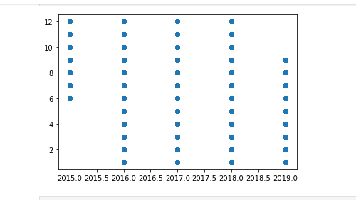
CORRELATION
YEAR V/S MONTH
INFERENCE:#year and hour are negatively correlated as coefficient is negative
data1=df['YEAR']
data2=df['MONTH‘]
pyplot.scatter(data1,data2)
pyplot.show()
corr,_=pearsonr(data1,data2)
print('Pearsons correlation: %.3f' % corr)
OUTPUT:Pearsons correlation :0.275

Slide 18
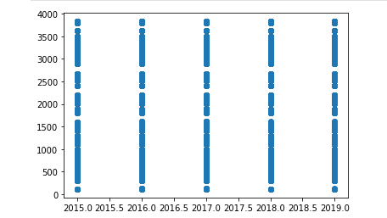
YEAR V/S OFFENCE CODE
INFERENCE:#year and offence code are posititively correlated as coefficient is positive
data1=df['YEAR']
data2=df[‘OFFENCE CODE‘]
pyplot.scatter(data1,data2)
pyplot.show()
corr,_=pearsonr(data1,data2)
print('Pearsons correlation: %.3f' % corr)
OUTPUT: OUTPUT:Pearsons correlation :0.040

Slide 19
HYPOTHESIS TESTING
import numpy as np
import pandas as pd
import matplotlib.pyplot as plt
import seaborn as sns
from sklearn.preprocessing import scale
#from scipy import stats
from statsmodels.stats import weightstats as mm
data=pd.read_csv("crime.csv",encoding='latin-1')
n=len(data["HOUR"])
mean=data["HOUR"].mean()
sd=data["HOUR"].std()
(n,mean,sd)
OUTPUT
319073, 13.118204924891796, 6.2942052659402385)

Slide 20
ztest,pvals=mm.ztest(data["HOUR"],value=13,alternative="larger")#value is the null hypothesis; larger is for alternate hypothesis: means prop > value.
print("p-value",pvals)
p-value=1.3654980917919807e-26

Slide 21
if pvals<=0.05:
print("We reject NULL hypothesis")
else:
print("We fail to reject the null hypothesis")
We reject NULL hypothesis

Slide 22
ANY QUESTIONS?

Slide 23
THANK YOU

